Slide 1
DemolitionCrew Milestones
ALESSIA PACCAGNELLA, NIKLAUS HOUSKA, ROGER BARTON

Slide 2
What we did since milestones
Fluid improvements
Tried out reseeding
Ghost fluid for pressure
Variable viscosity
Link fluid and temperature simulation
Particles carry temperature
Optimization:
Use Eigen::MatrixXd instead of Array2D
Tried out float vs double, no noticeable improvements
(Clean up, bug fixes, document, improve UI)

Slide 3
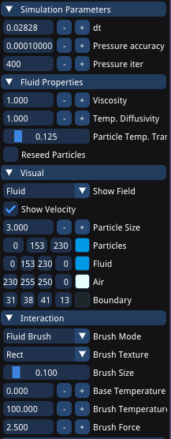
UI

Slide 4
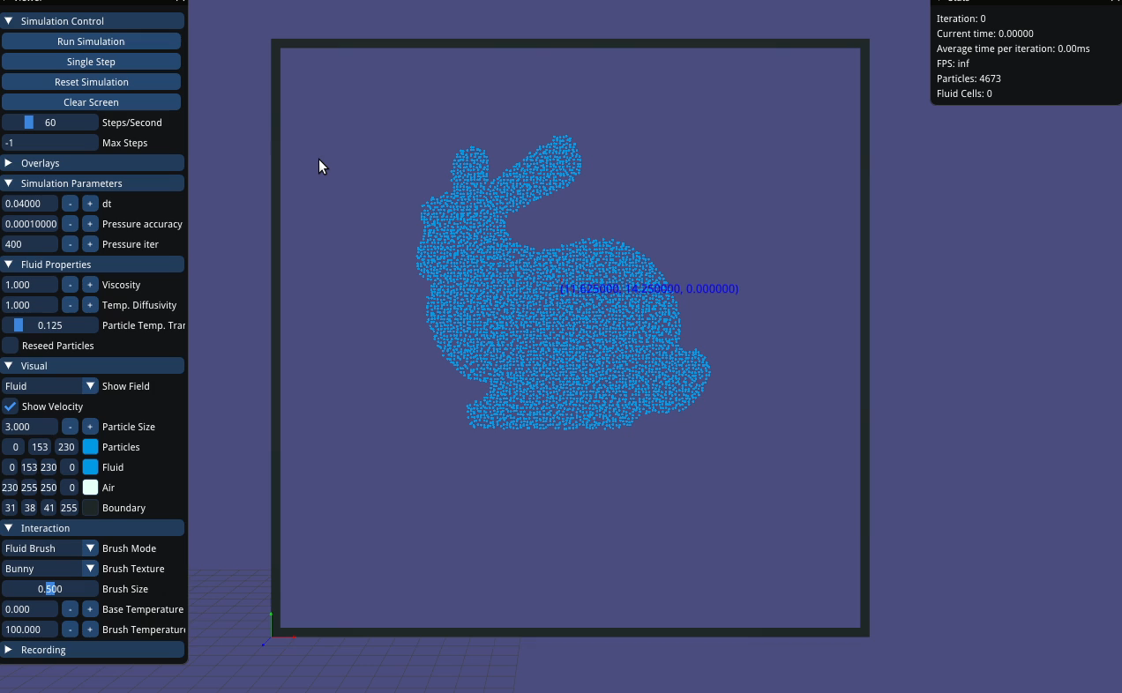
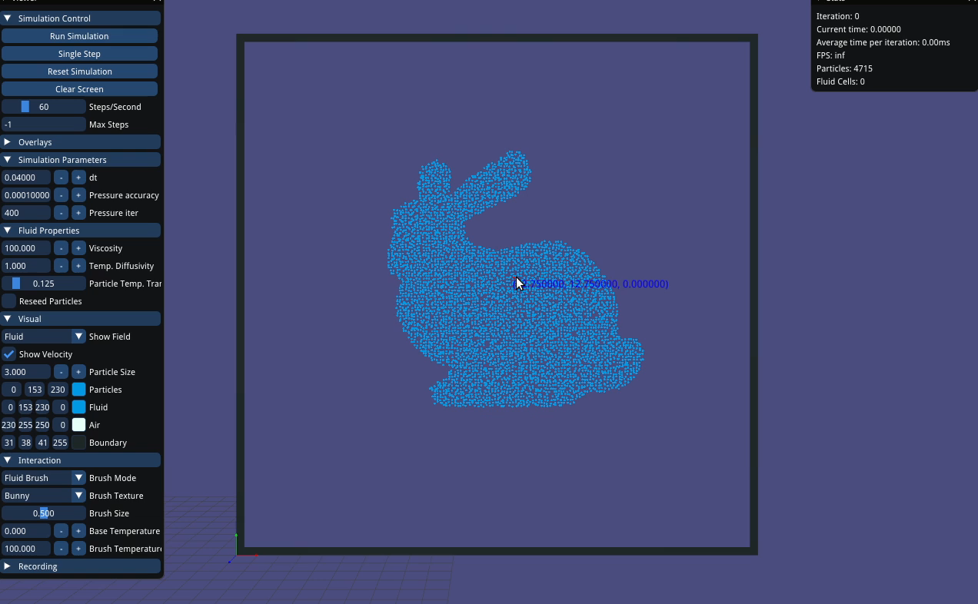
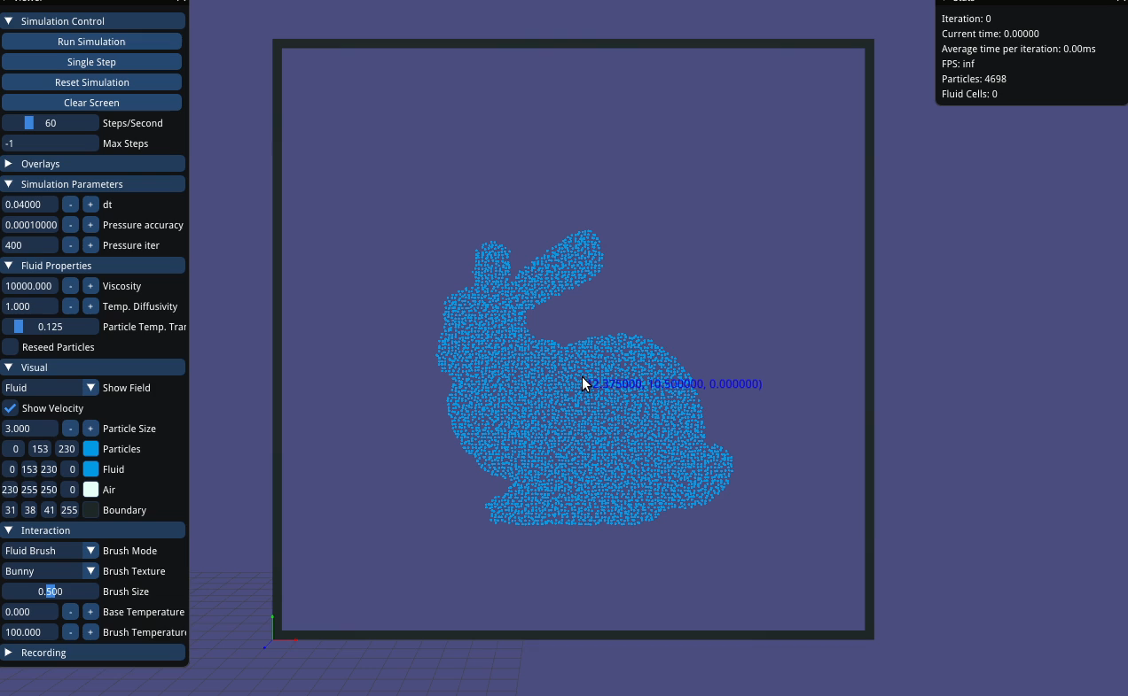
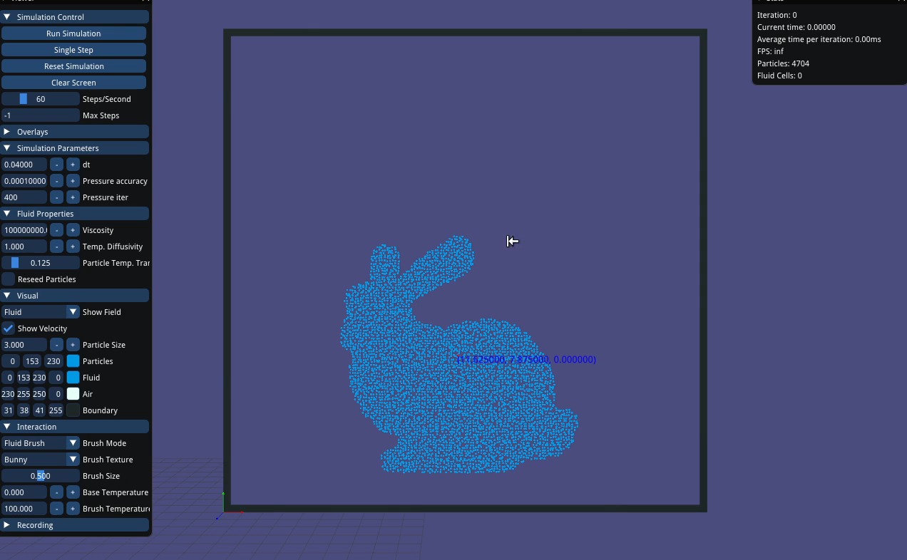
Viscosity: 1
Viscosity: 1k
Viscosity: 10k
Viscosity: 100m

Slide 5
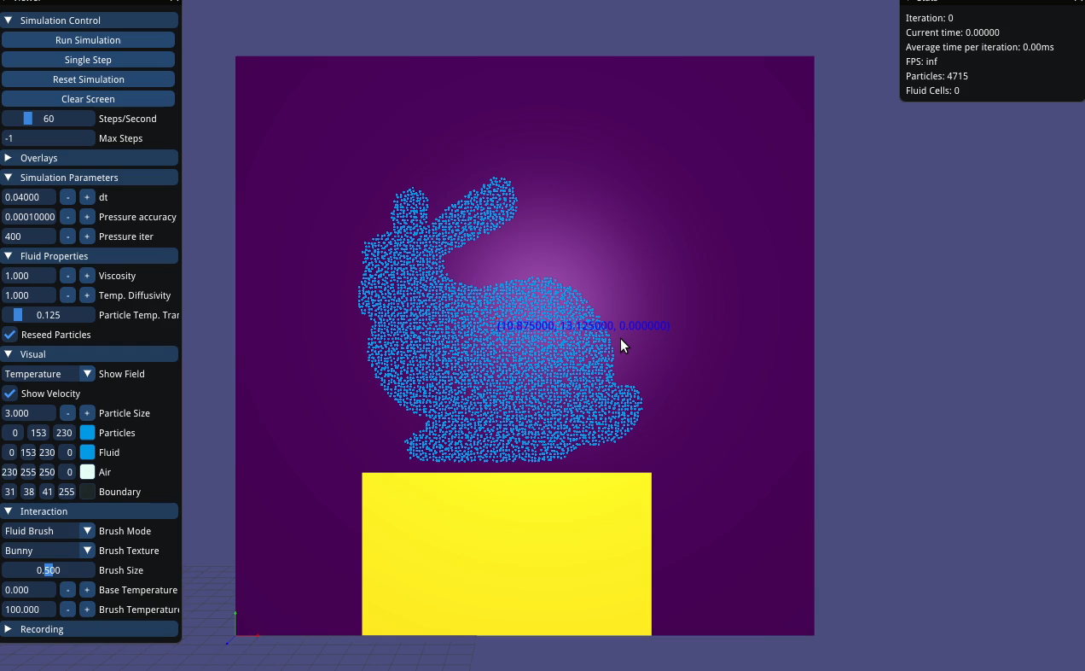
Temperature linked with fluid

Slide 6
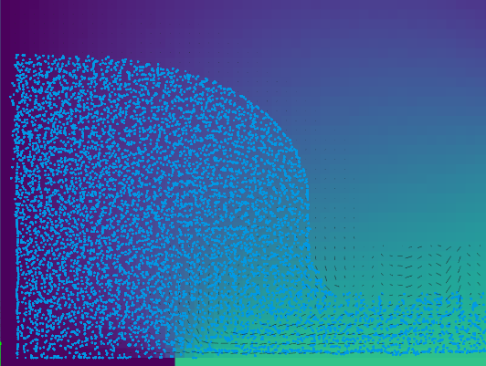
Ghost pressure gives smoother boundary

Slide 7
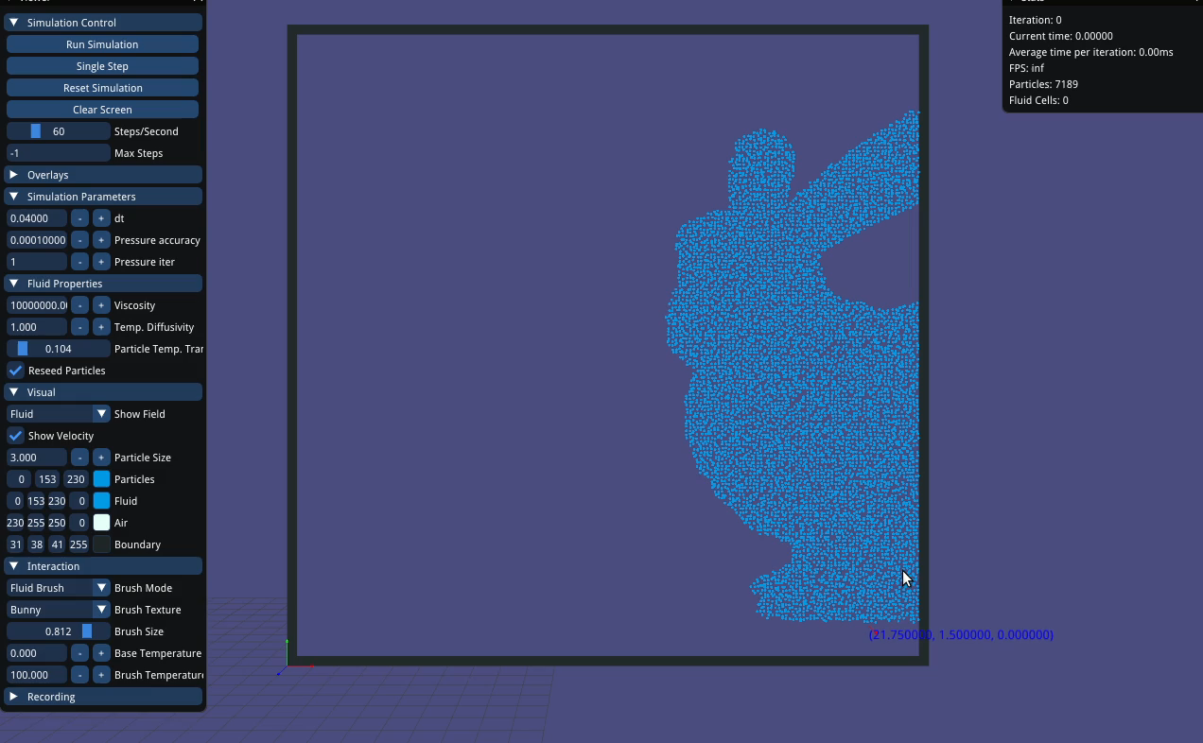
Side effect
Leave out pressure solver
Strange behaved viscosity solver
Viscosity: 10m

Slide 8
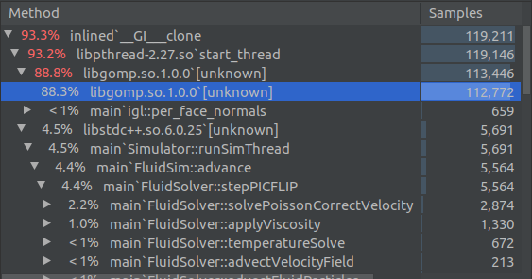
Profiling Runtime
Mostly Eigen::ConjugateGradient solvers
Could be improved with an adaptive domain
May not make sense due to the overhead

Slide 9
What we left out
3D -> focused on real-time and interactivity instead
SDF for solids

Slide 10
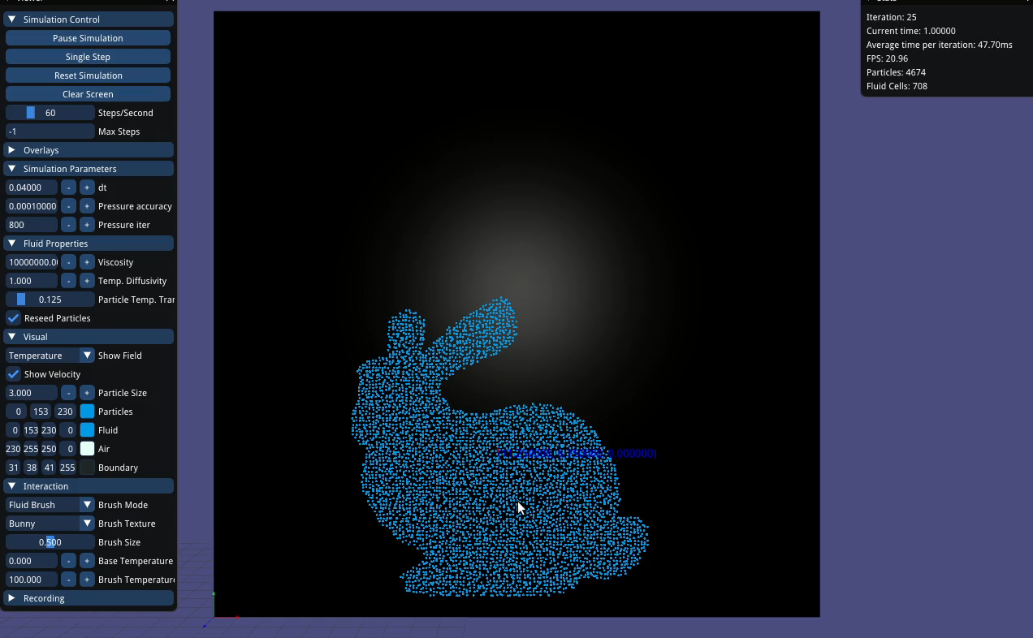
Notes:
Optional Slide

Slide 11
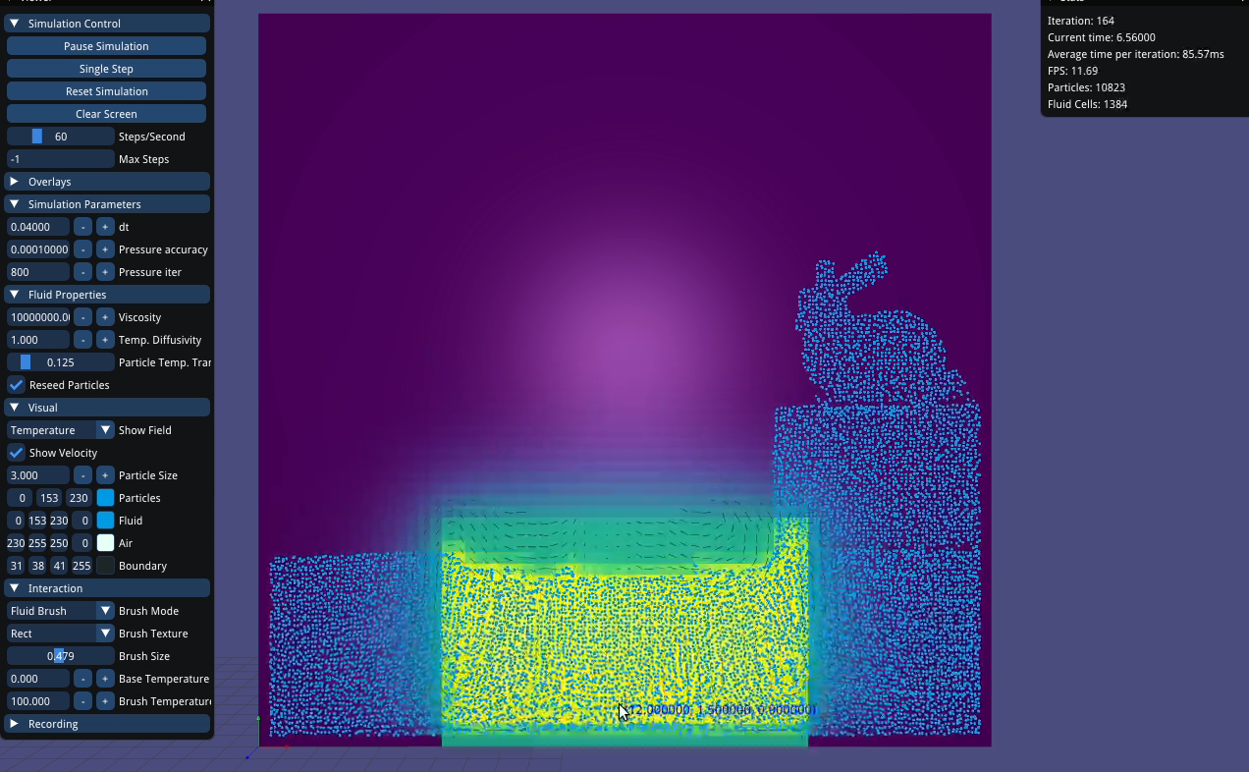
Notes:
Crop to 20s start

